Slide 1
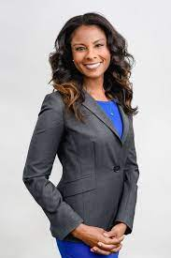







Data Analyst Sarah Ali
Current Daily Work Environment:
Operates remotely and sometimes on-site meetings
Collaborates closely with team members for data-centric projects
Challenges:
Speed vs. Accuracy:
Balancing quick report generation with data accuracy.
SQL Complexity:
Managing complex SQL queries, especially with large datasets.
Data Integrity:
Ensuring reliability in population reports.
Experience with tools and Technologies:
Experienced in data visualization tools like Tableau and Power BI
Good understanding with statistical analysis software such as R and Python
Utilizes collaboration tools like Slack and Zoom for effective team communication
Preferred Learning Style:
Prefers hands-on workshops and interactive learning experiences
Subscribes to data science blogs and follows influencers on social media
Age: 28
Income: 45k per year
Job Title: Population Data Analyst
Education: Bachelor's degree in Statistics Brunel university
Work Experience: 5 years of experience as data analysis at Bupa
Goals
Interested in furthering expertise in machine learning and predictive analytics
Aims to assume a leadership role in data science within the next 3 years
Hobbies and Interests:
Enjoys attending data science meetups and webinars
Participates in online forums like discord to discuss emerging trends in data analysis
Unique Traits:
Detail-oriented and analytical
Enjoys solving problems and identifying patterns in data
Actively seeks to stay updated on the latest data analysis techniques
English – Read / Write
Arabic - Read / Write
Spanish Read / Write

